Slide 1
Experiments - NIM-PET

Slide 2
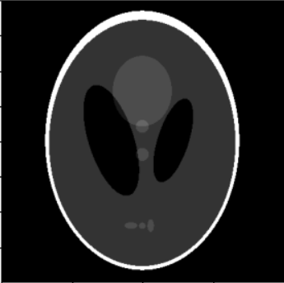
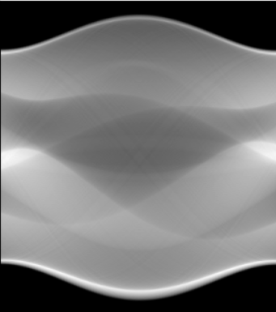
Experiment 3 - Image Denoising
Y
SIREN
X
Model output
Model input
Loss = MSE( Sinogram, Shepp-Logan Sinogram)
Sinogram

Slide 3
Results
Noise | Optimizer | LR | Omega_0 | Angles | Steps | MSE sinog | PSNR Sinog | MSE Img | PSNR Img
NO | ADAM | 1,00E-04 | 20 | 100 | 4000 | 0,6152 | 34,4555 | 0,0016 | 27,84
NO | ADAM | 1,00E-04 | 30 | 100 | 4000 | 0,3427 | 37,3921 | 0,001 | 29,9787
NO | ADAM | 1,00E-04 | 40 | 100 | 4000 | 0,2303 | 41,3523 | 0,00079 | 31,0034
YES | ADAM | 1,00E-04 | 40 | 100 | 4000 | 0,9079 | 39,7258 | 0,0010 | 30,0940
YES | ADAM | 1,00E-04 | 40 | 80 | 4000 | 0,8547 | 38,393 | 0,0011 | 29,5555
YES | ADAM | 1,00E-04 | 40 | 60 | 4000 | 0,8301 | 38,6559 | 0,0013 | 28,8545
YES | ADAM | 1,00E-04 | 40 | 40 | 4000 | 0,7552 | 40,4252 | 0,0023 | 26,4688

Slide 4
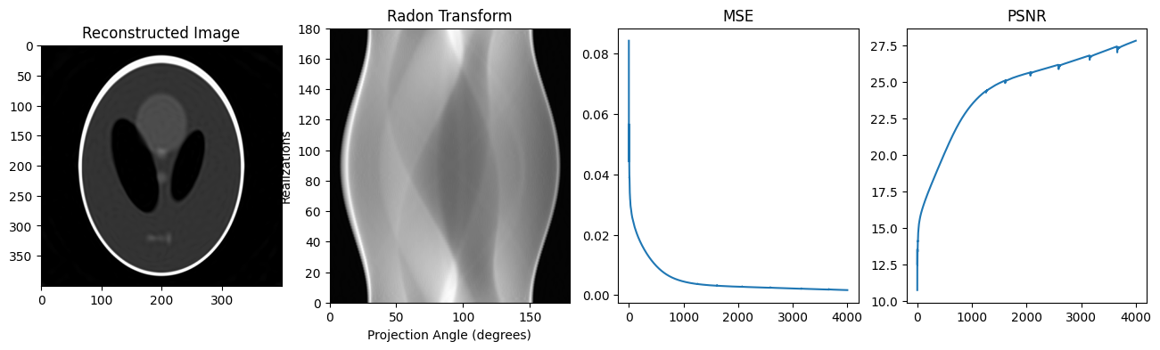
Adam : LR=1e-4 - Angles 100, 4000 steps, Omega 20

Slide 5
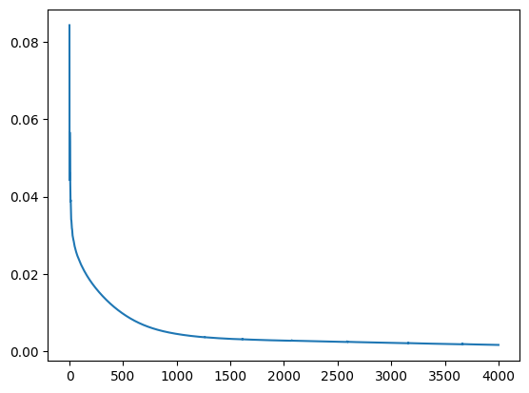
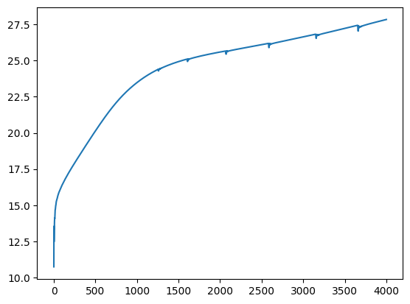
Adam : LR=1e-4 - Angles 100, 4000 steps, Omega 20

Slide 6
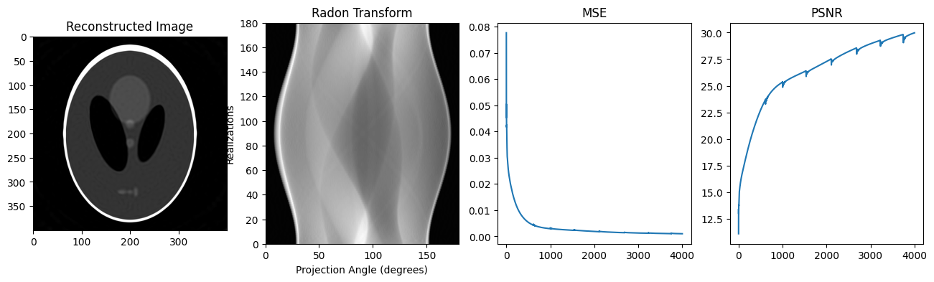
Adam : LR=1e-4 - Angles 100, 4000 steps, Omega 30

Slide 7
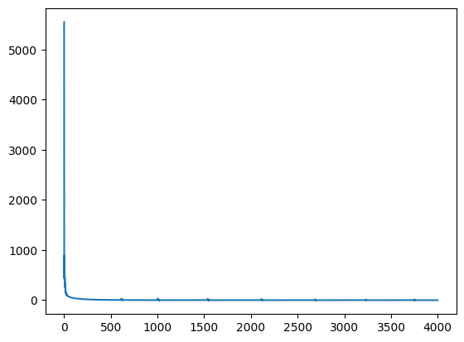
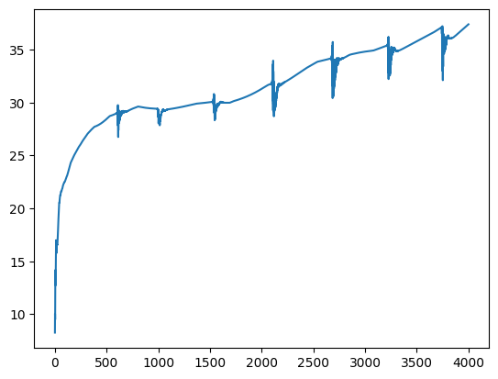
Adam : LR=1e-4 - Angles 100, 4000 steps, Omega 30

Slide 8
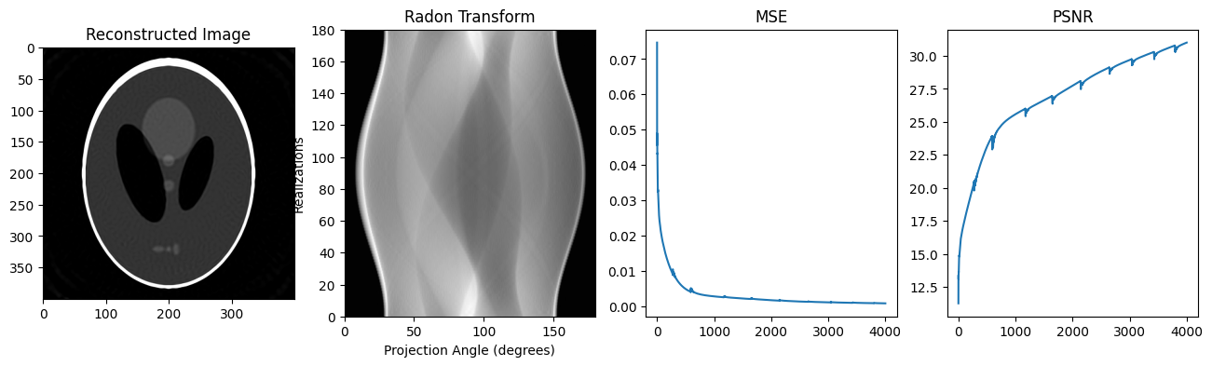
Adam : LR=1e-4 - Angles 100, 4000 steps, Omega 40

Slide 9
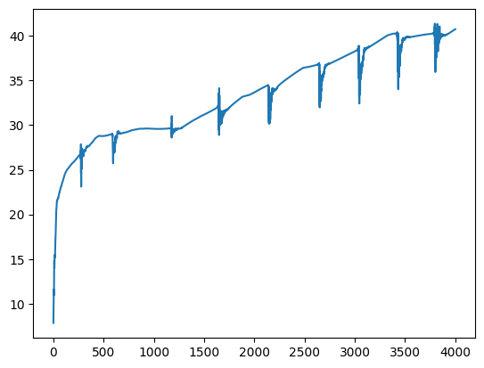
Adam : LR=1e-4 - Angles 100, 4000 steps, Omega 40

Slide 10
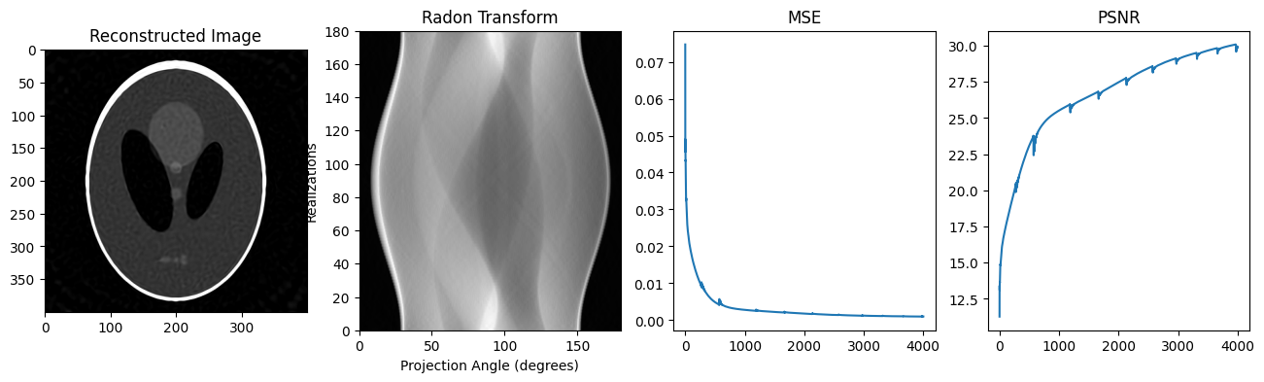
Adam : LR=1e-4 - Angles 100, 4000 steps, Omega 40, Gaussian Noise (0, 1)

Slide 11

Adam : LR=1e-4 - Angles 80, 4000 steps, Omega 40, Gaussian Noise (0, 1)

Slide 12

Adam : LR=1e-4 - Angles 60, 4000 steps, Omega 40, Gaussian Noise (0, 1)

Slide 13
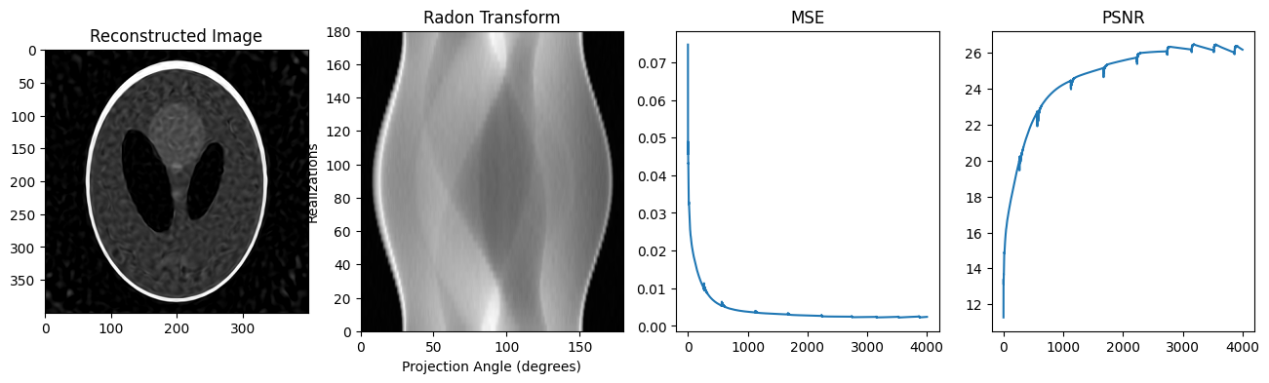
Adam : LR=1e-4 - Angles 40, 4000 steps, Omega 40, Gaussian Noise (0, 1)

Slide 14
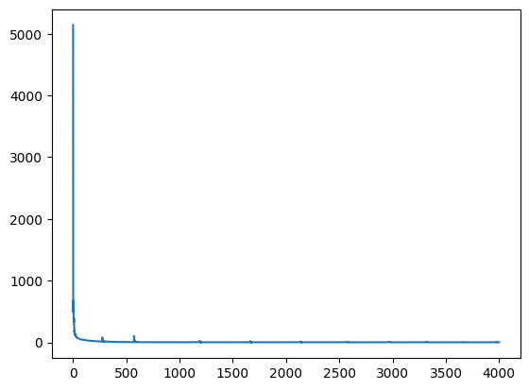
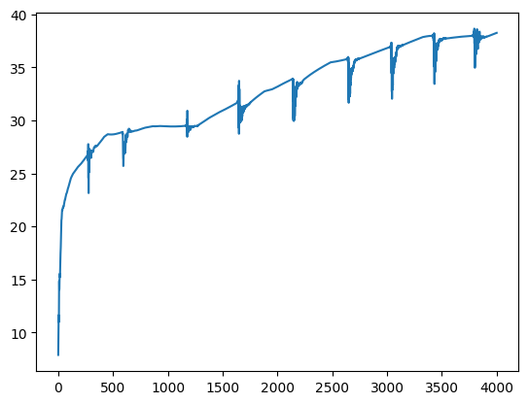
Adam : LR=1e-4 - Angles 100, 4000 steps, Omega 40, Gaussian Noise (0, 1)

Slide 15

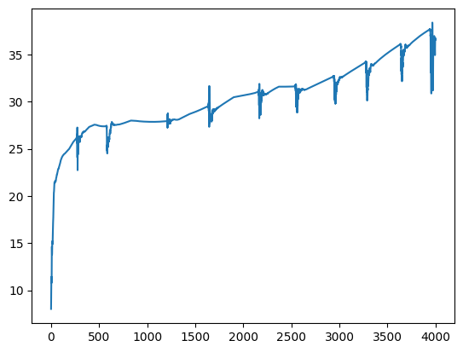
Adam : LR=1e-4 - Angles 80, 4000 steps, Omega 40, Gaussian Noise (0, 1)

Slide 16

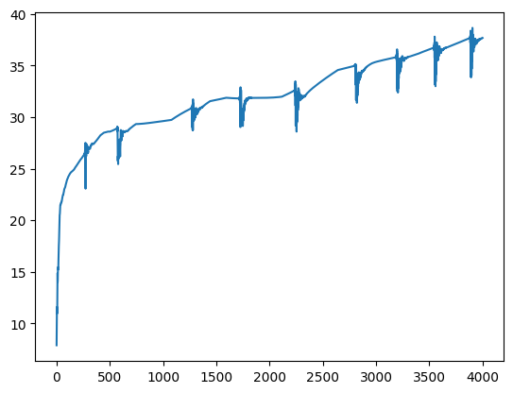
Adam : LR=1e-4 - Angles 60, 4000 steps, Omega 40, Gaussian Noise (0, 1)

Slide 17

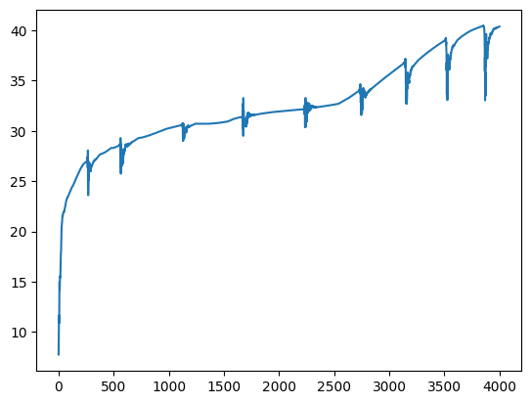
Adam : LR=1e-4 - Angles 40, 4000 steps, Omega 40, Gaussian Noise (0, 1)

